Slide 1

MEV across crypto in 2021
Robert Miller
MEV.day, Amsterdam

Slide 2
MEV activities at 30,000 feet
I want to talk about three broad categories of MEV activities today
Extraction: efforts to capture MEV across crypto
Externalities: negative effects from MEV extraction
Mitigation: efforts taken to reduce negative externalities
We’ll begin by looking at some numbers
Notes:
extraction:
eth l1 and flashbots
alt-evm l1 spam
rollup latency games
Solana
externalities:
sandwiching
avalanche chain slowing down
avalanche chain almost stopping from node overload
solana downtime
polygon / bsc / near spam
mitigation:
flashbots mev-geth
flashbots protect
avalanche snowman++
future: osmosis threshold decryption, “fair" ordering

Slide 3
MEV by the numbers: ETH L1
mev-explore: $475.41m
community 🥪 profit estimate: $379.92m
NFT MEV: ~$75m?
Maker liquidations: ~$25m?
Other long tail (liquidity sniping, etc): ~$50m?
Total: ~$900m - $1bn
Not included: non-atomic arb, e.g. CEX <> DEX arbs

Slide 4
MEV by the numbers: other L1 chains
Polygon: $43.3m
BSC: $55.79m
Avalanche: $18.84m
Solana: $8.31m
Total: ~$126m
Sources
Polygon: Marlin Protocol, Explore, Jan 1st - Dec 31st 2021
BSC: Eigenphi, June 1st - Dec 31st 2021
Avalanche: Will Sheehan, August 1st - Dec 31st 2021
Solana: 0xMisaka, August 1st - Dec 31st 2021

Slide 5
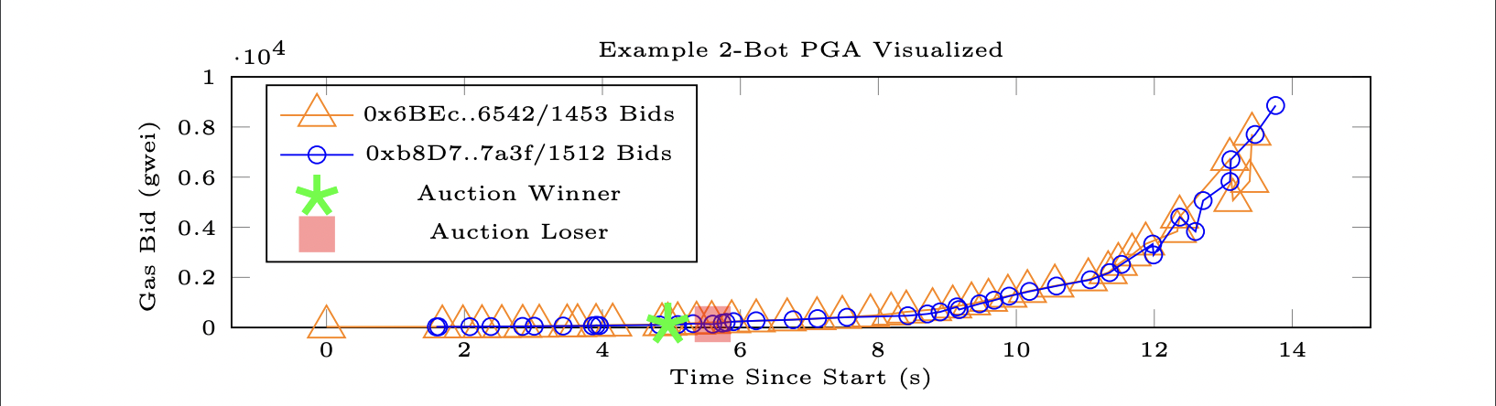
Extraction strategy: Priority Gas Auctions
An iterative game where bots competitively bid up transaction fees in an effort to receive priority in a block
Bots competing on having the best networking, latency, and view of the mempool

Slide 6
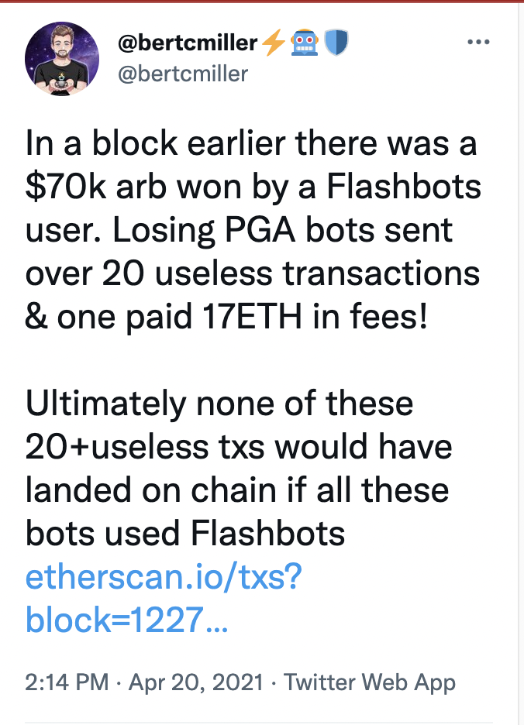
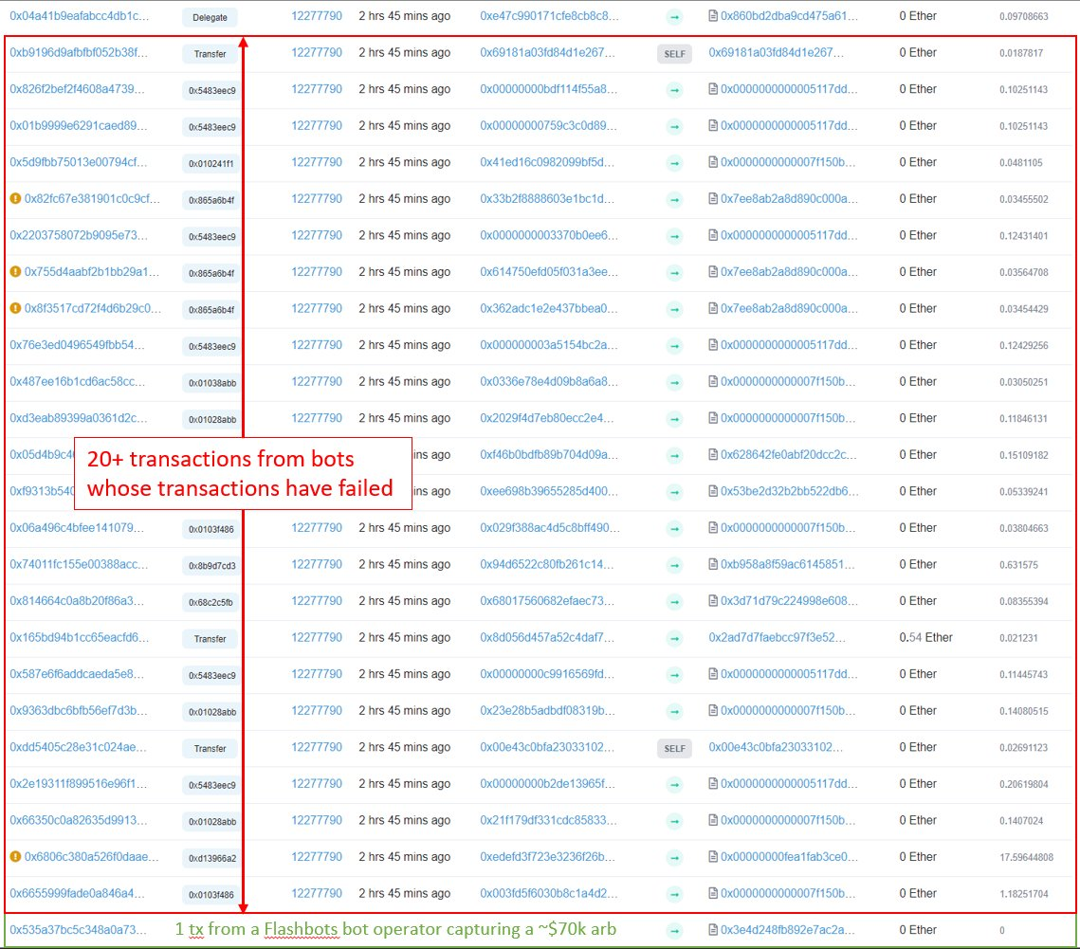
Externality: wasted blockspace

Slide 7
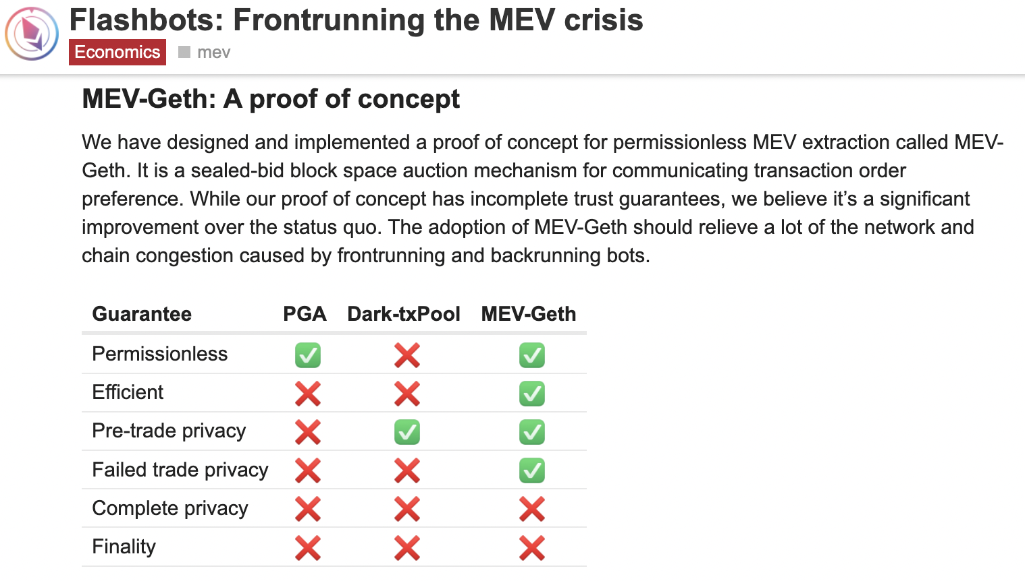
Mitigation: MEV-Geth
Mitigated
Wasted blockspace from failed MEV transactions
Centralization risk that unequal MEV extraction posed

Slide 8
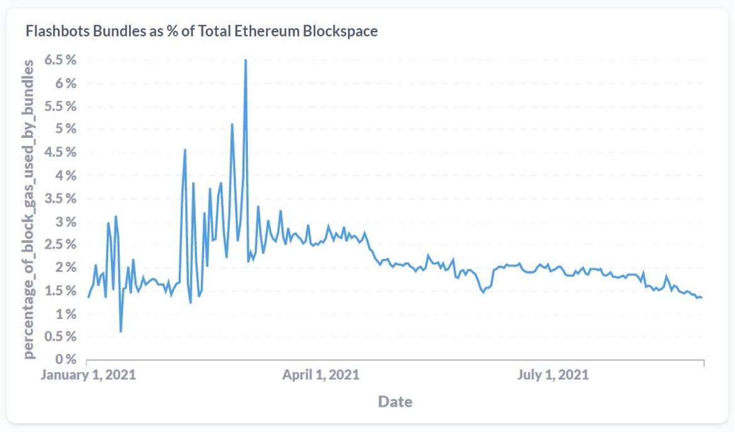
Extraction strategy: Flashbots Auction
The Flashbots Auction optimizes for gas price to decide which txs get included
Searchers are incentivized to make their MEV extraction as efficient as possible
The majority of MEV for common strategies gets paid to miners
Searchers are also incentivized to find novel forms of alpha where there is less competition

Slide 9
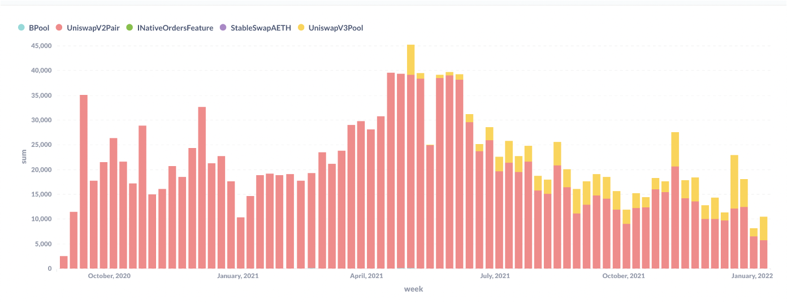
Externalities: sandwiches on Ethereum

Slide 10
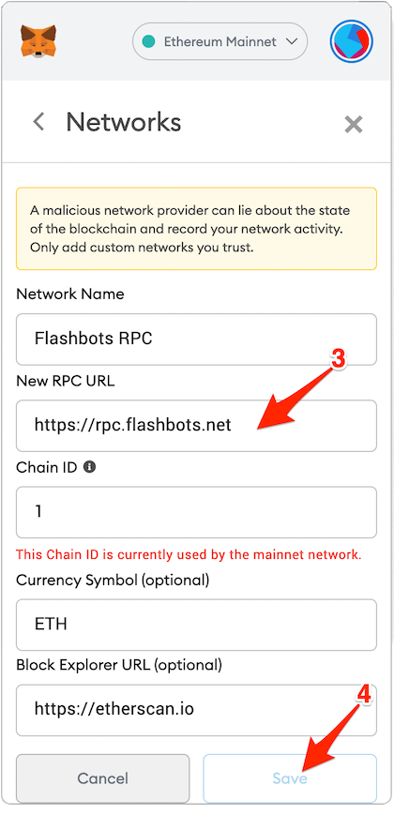
Mitigation: Flashbots Protect
Mitigated
Frontrunning risk to users from sending their trades in the public mempool
No gas cost from failed transactions
Add https://rpc.flashbots.net to your MetaMask to use Flashbots Protect!

Slide 11
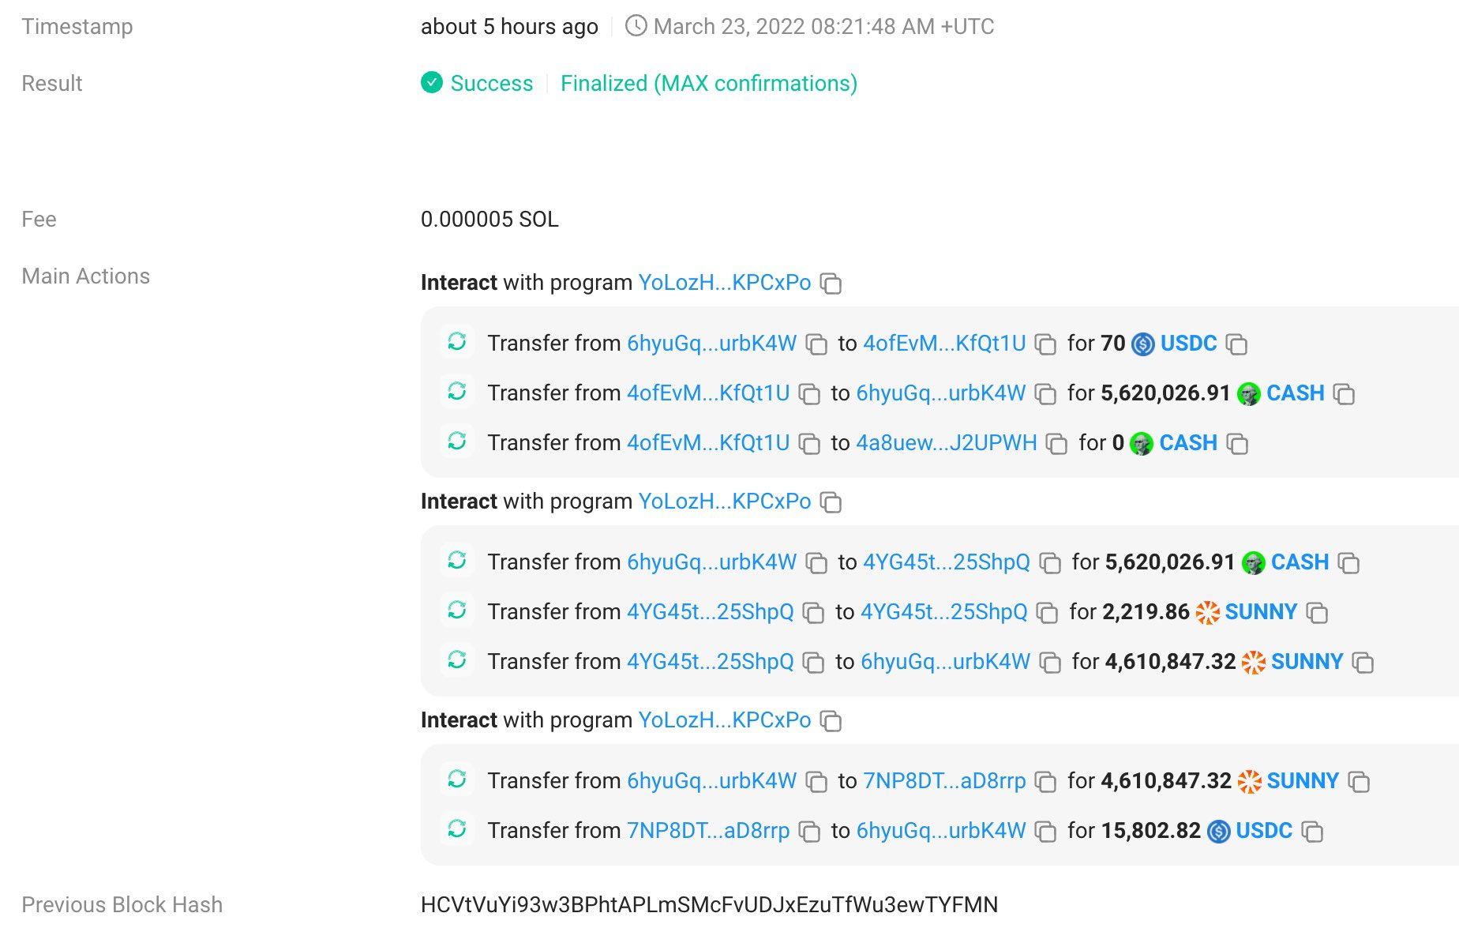
Extraction strategy: on-chain search spam
For a chain with first-come-first-serve ordering and fast block times, if blockspace is cheap enough then searchers will look for MEV on-chain
e.g. some Solana bots will flood the network with transactions that look for arbs on-chain, hoping that they land behind a transaction that generated one, and reverting if not

Slide 12
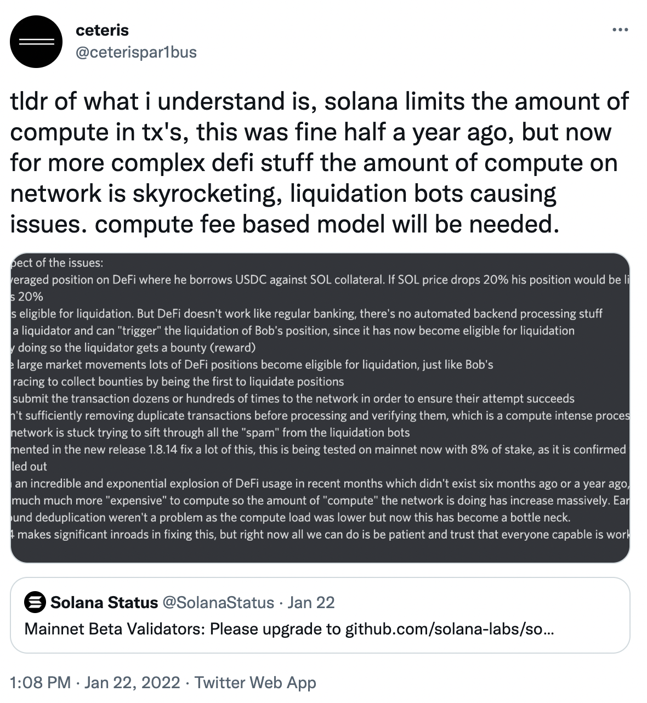
Externalities: MEV leading to downtime for users

Slide 13
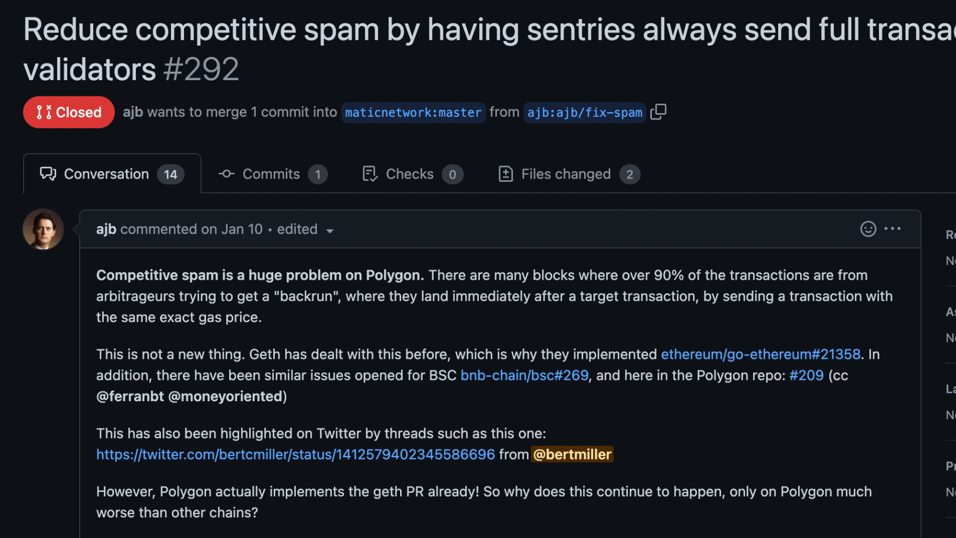
Extraction strategy: network propagation spam!
There is randomness in which transactions are propagated to Polygon and Solana validators
If you want to ensure your transaction gets to a validator in time, you are incentivized to spam the validator with transactions!
https://github.com/maticnetwork/bor/pull/292

Slide 14
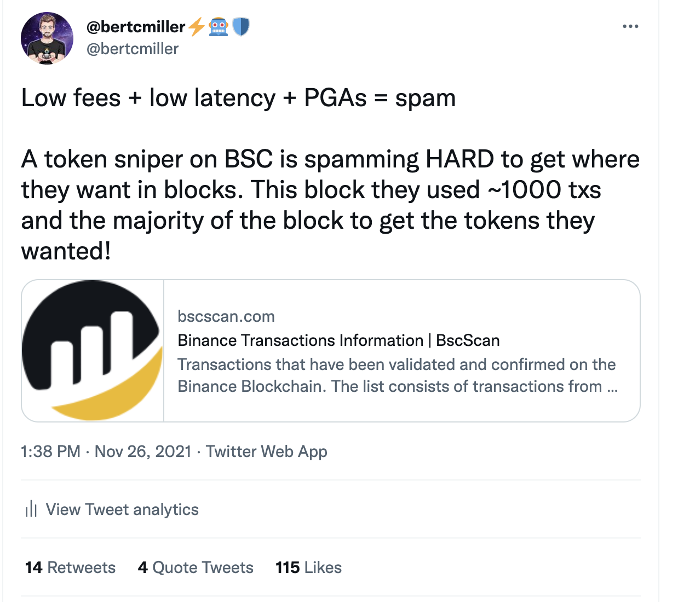
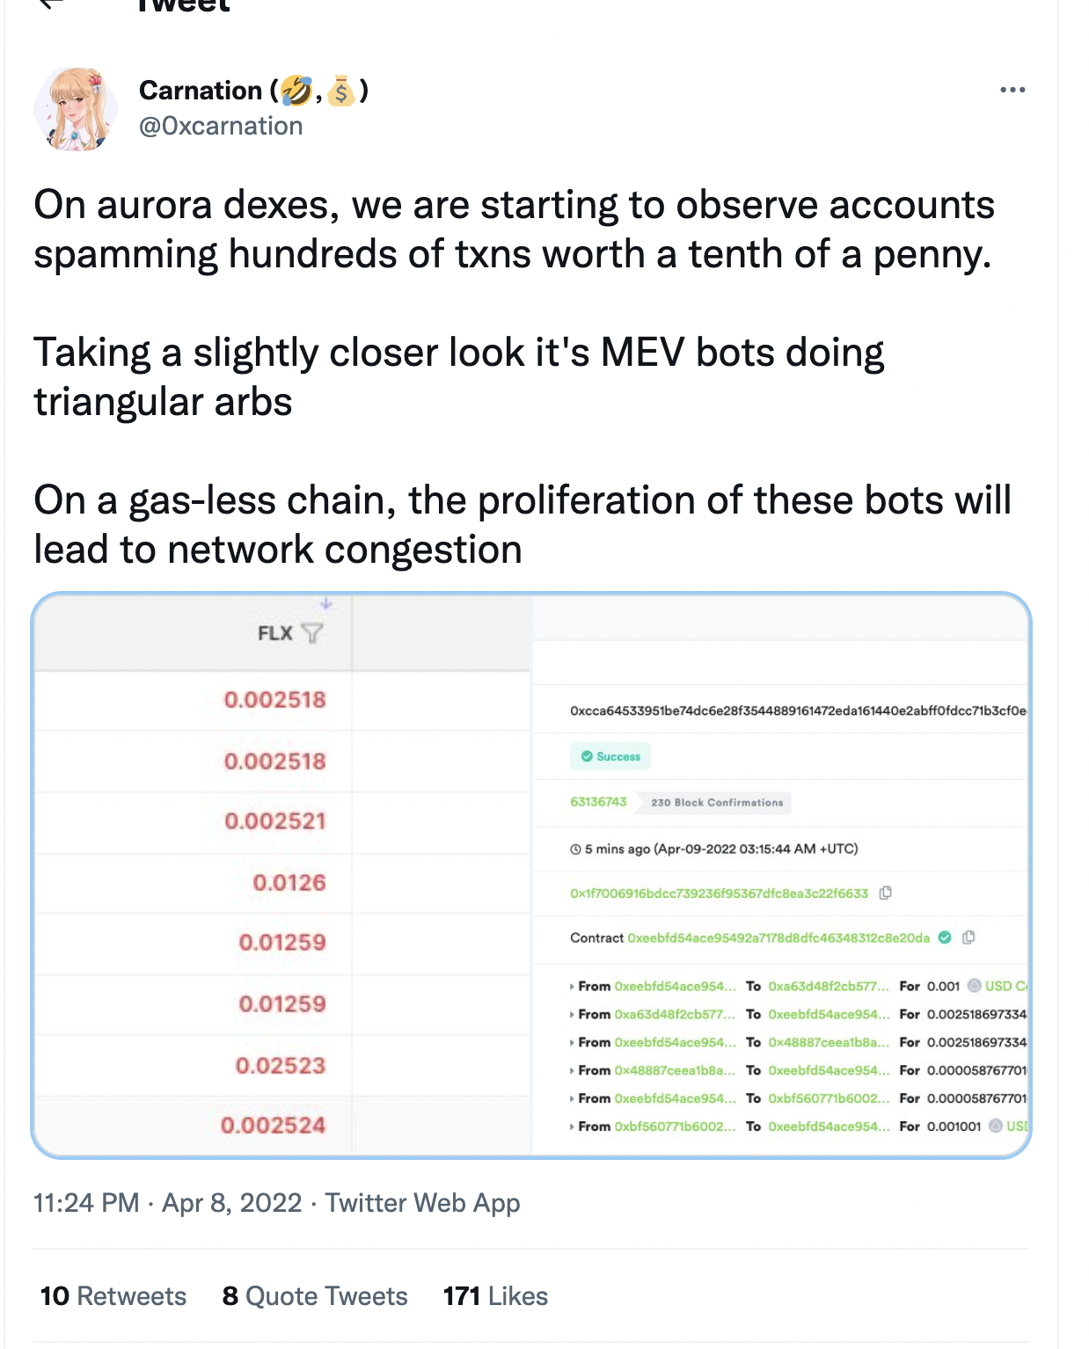
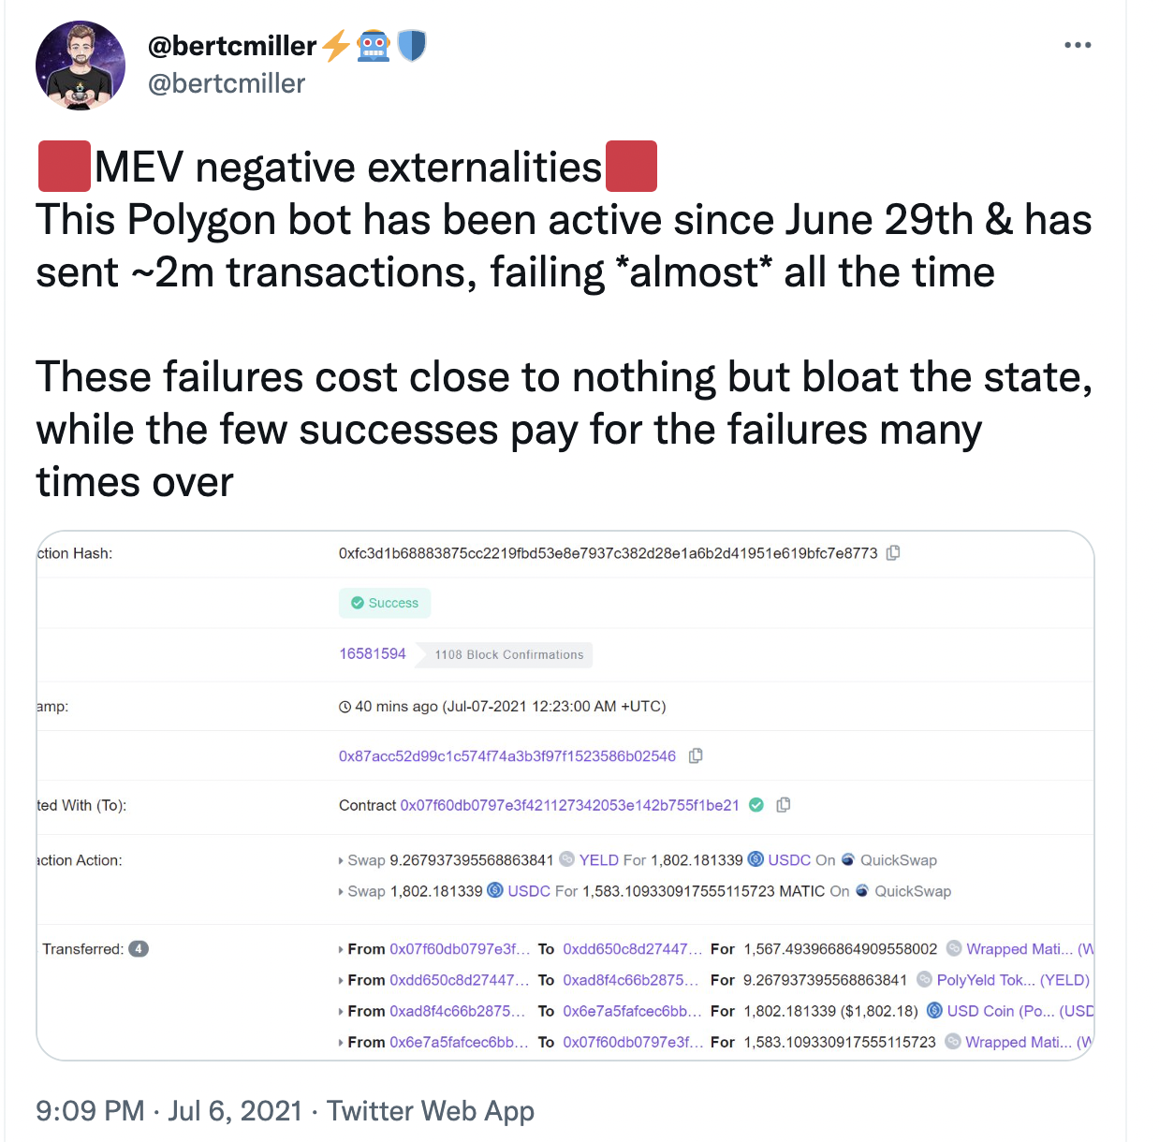
Externalities: spam!
Wastes blockspace and raises cost for regular users
Adds a ton of load to the p2p layer
Bloats state over time

Slide 15
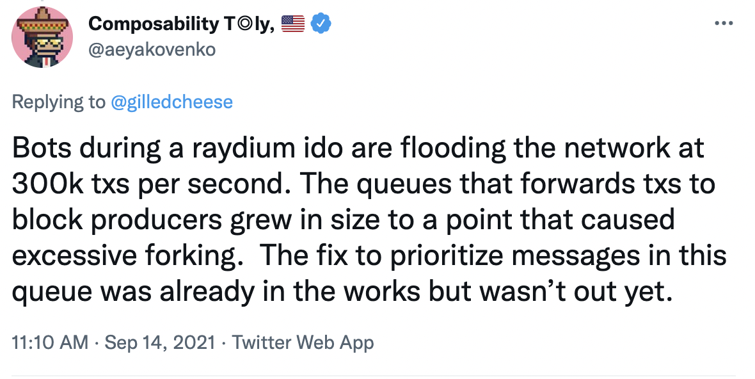
Externalities: spam bringing networks down
Mitigation: fee markets, block producer optimizations

Slide 16
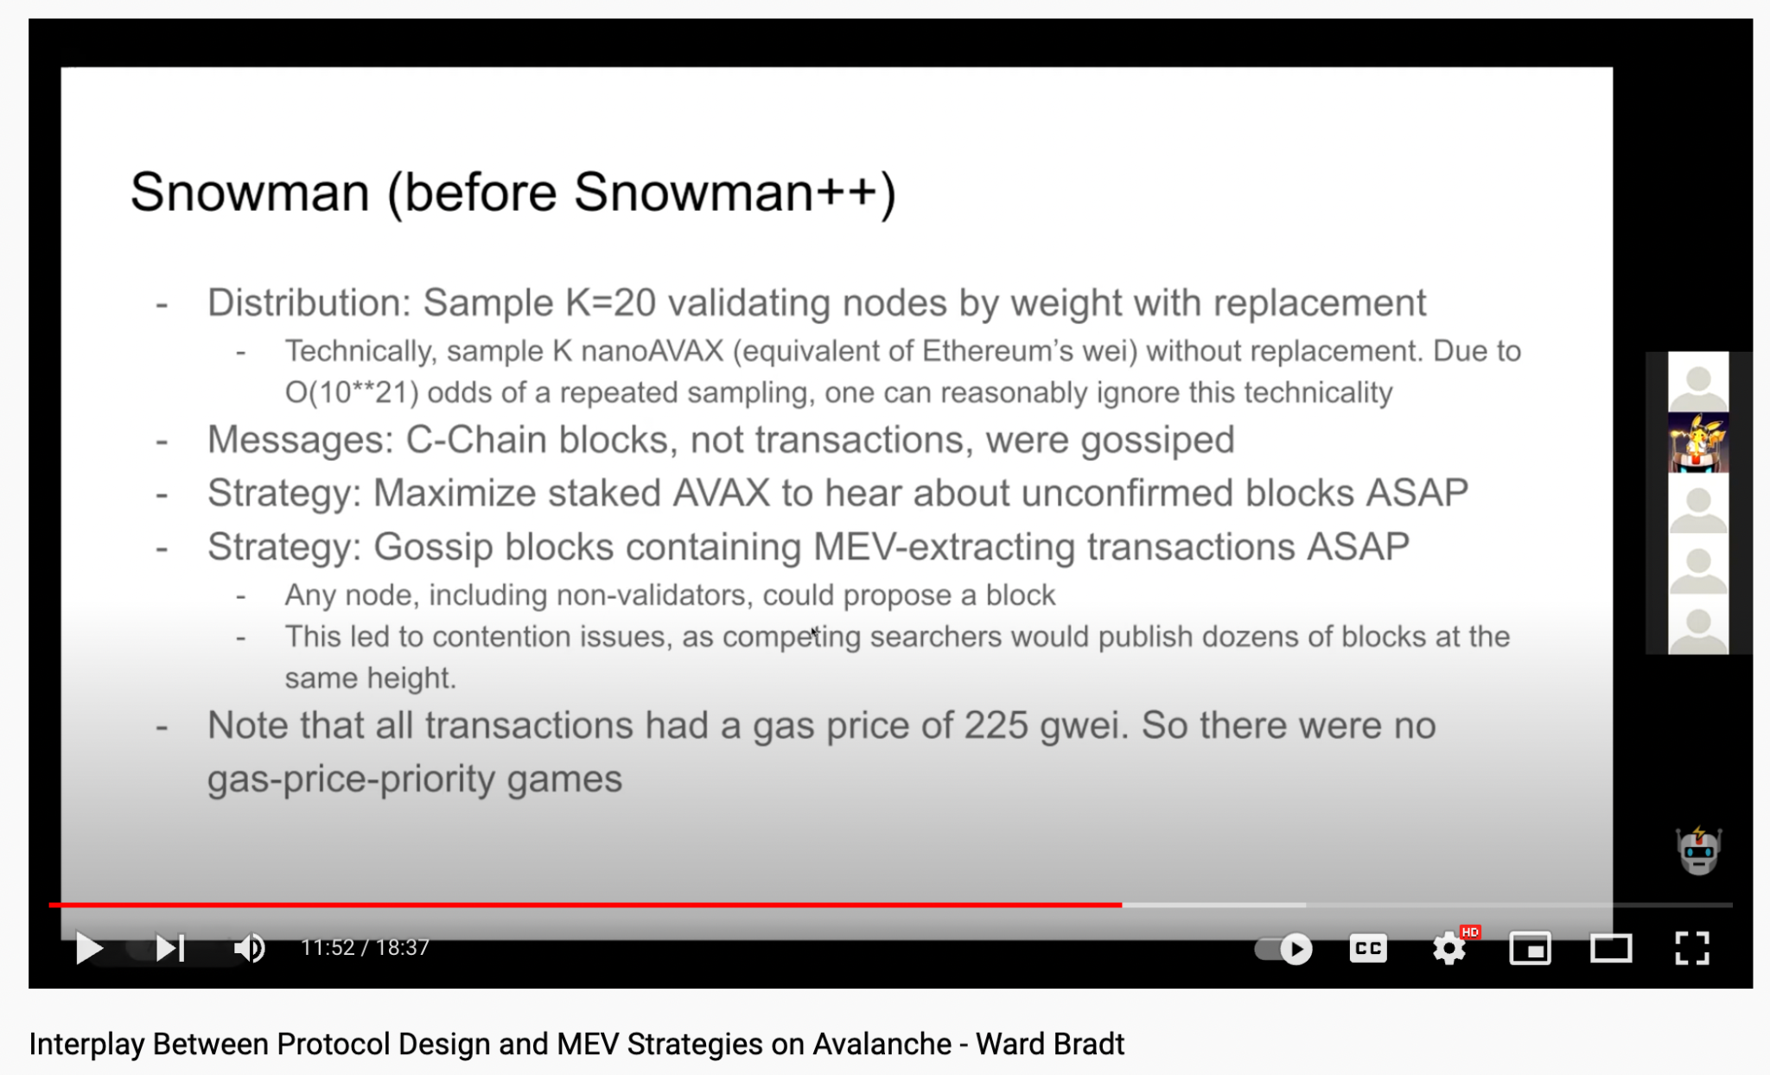
Extraction strategy: maximize stake weight, fast gossip
Pre-snowman++! Not anymore!
Maximizing your % of stake to hear about unconfirmed blocks ASAP
Gossip blocks with MEV extraction ASAP, even with full nodes
Result: lots of competing blocks leading to longer time to finality
https://www.youtube.com/watch?v=1NmVORC2R-A

Slide 17
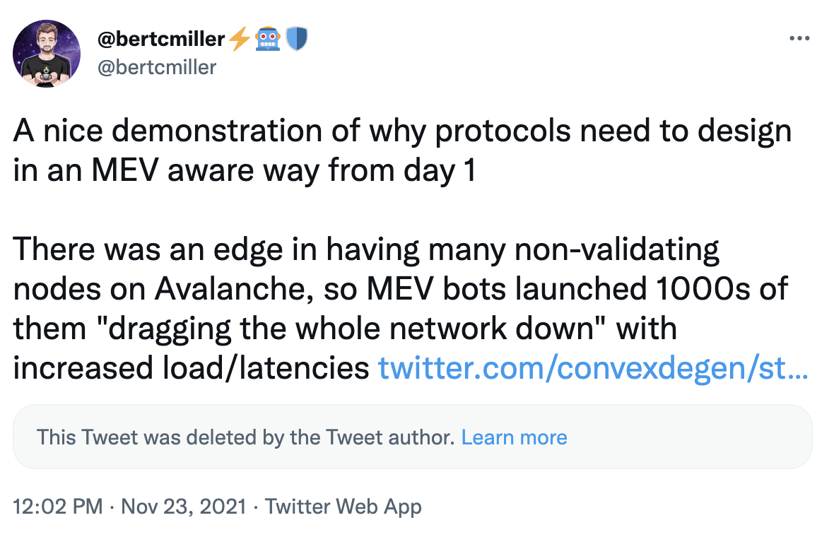
Externalities: MEV leading to networking load

Slide 18
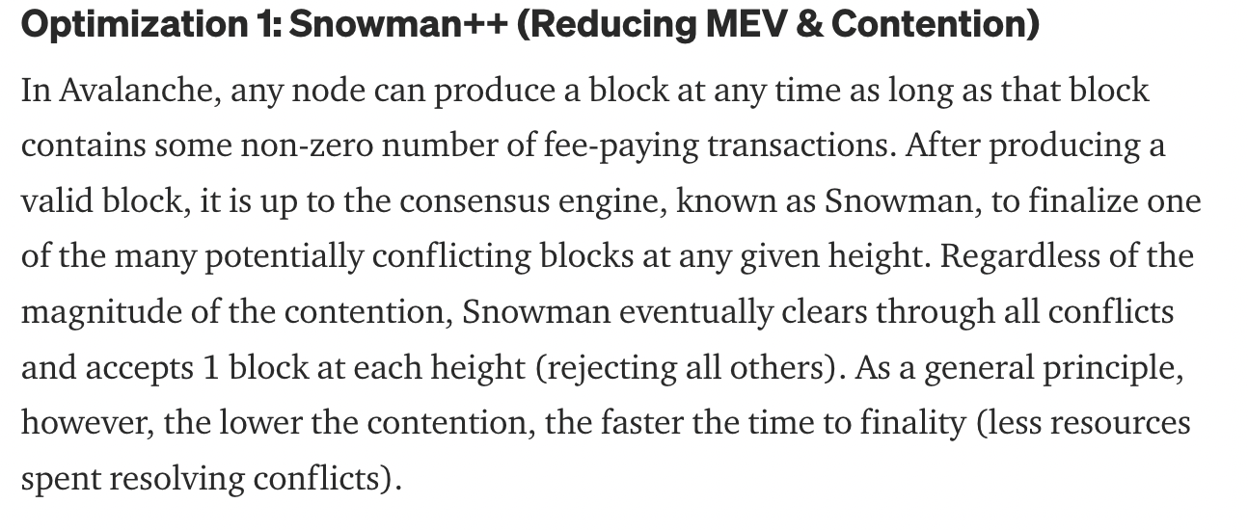
Mitigation: Snowman++

Slide 19


Extraction strategy: latency optimization
First-come-first-serve chains with moderate and up fees (e.g. rollups) incentivize searchers to try to have the lowest latency possible
Latency games I’ve seen:
An underground full node guide being passed around discord when there was no public guide for a rollup
Searchers launching 1000s of AWS servers to find the one that is closest to a sequencer
An oracle team also running a liquidation bot

Slide 20
Externality: block producer centralization
The faster your block time the harder it is to optimize for MEV extraction in that time
Searchers are incentivized to colocate with validators (or become one), these kinds of deals are hard to make transparent or democratize
Intuition: chains where latency optimization is the dominant strategy trend towards block producer centralization over time
Besides, do we really want to reproduce HFT style latency wars in crypto again?

Slide 21
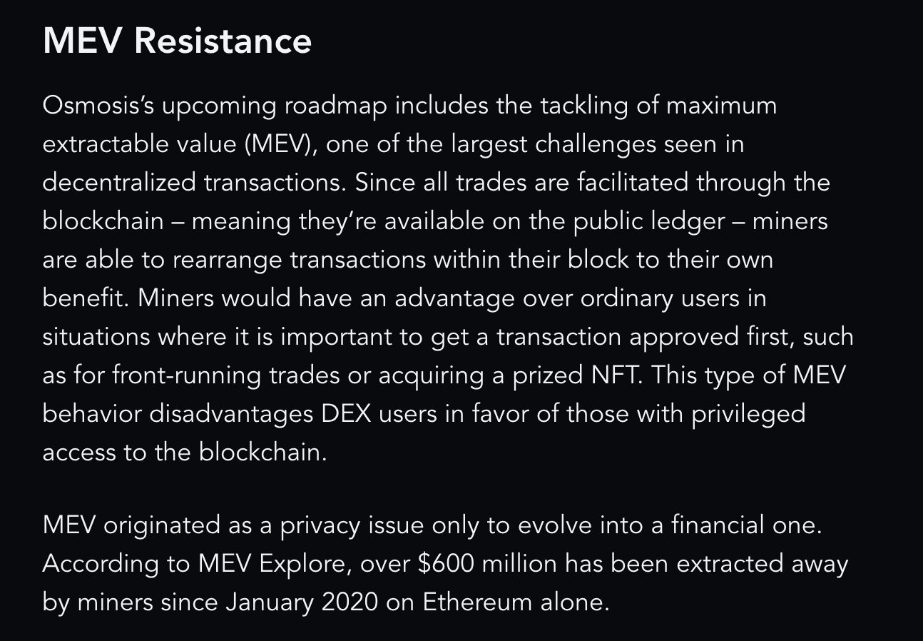
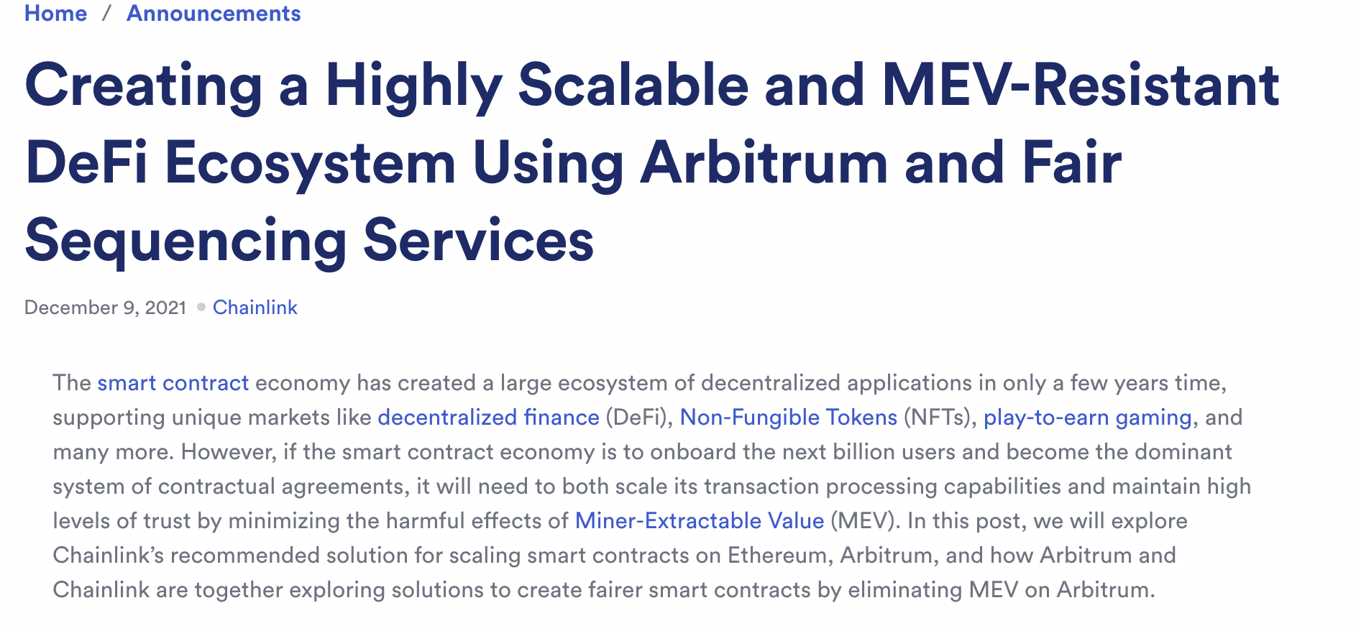
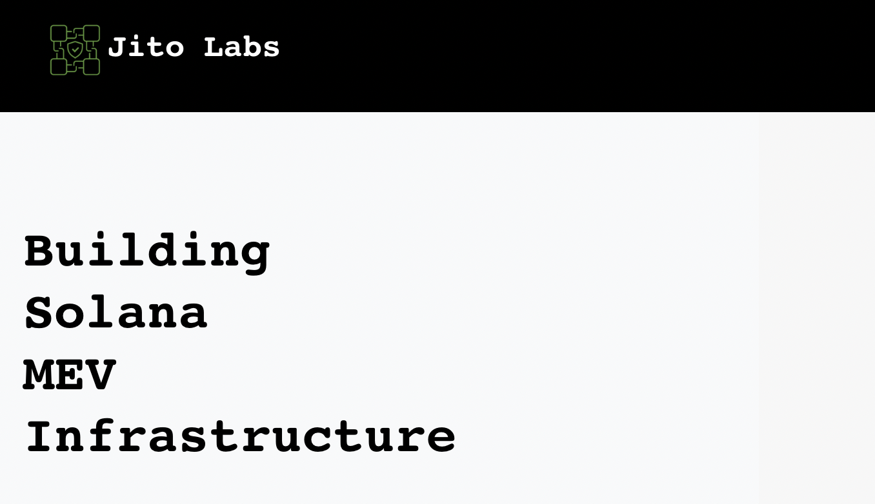
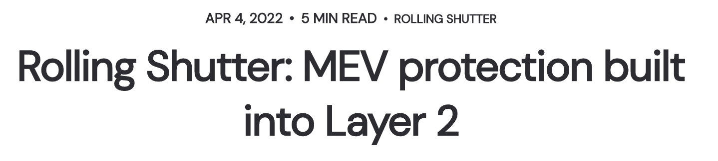
Mitigations on the horizon

Slide 22
Summary
In 2021 across crypto we saw:
The rise of a professionalized class of MEV extractors
As a lower bound over a billion dollars in MEV captured
Protocol design being stress tested under adversarial conditions
Networks buckling and even failing under stress from MEV searchers
MEV mitigations were implemented, more are being pursued in 2022
Thanks for listening :)
@bertcmiller on Twitter / Telegram
botcmiller#4207 on Discord

